Slide 1
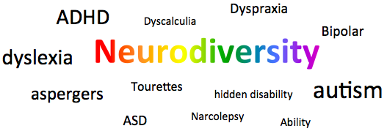

Slide 2
Stigma
Stigma was the main concern raised, the result of which means people are less willing to disclose and therefore unable to get the support they may need.

Slide 3

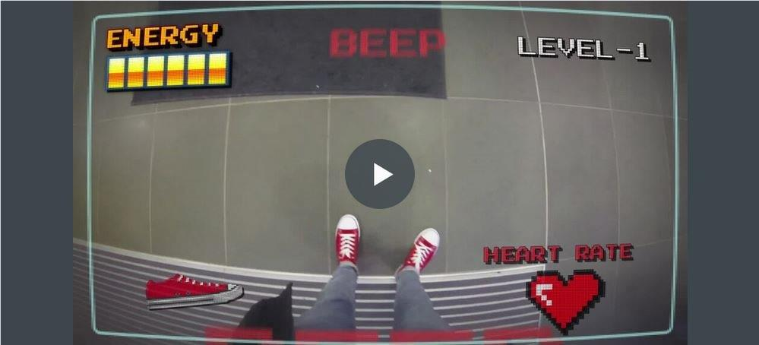

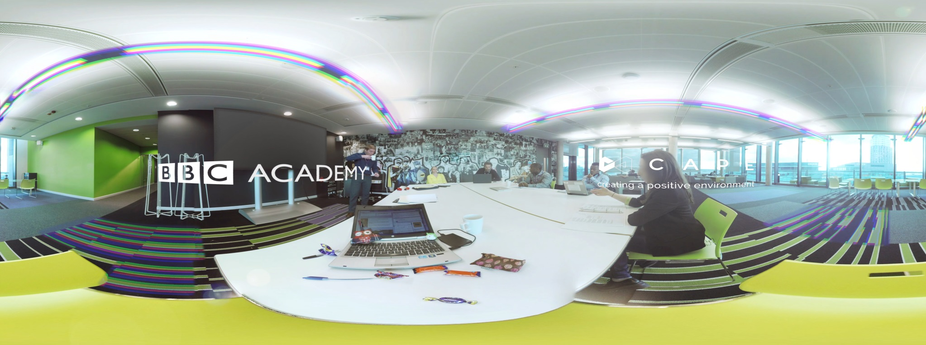
Empathy through Content
Notes:
Examples of Best Practice:
Education was something we wanted to tackle, to raise the profile of Neurodivergency through understanding and empathy rather than use traditional themes around awareness. We wanted to tell someone’s story rather than present someone as the story. So, we produced 3 films with the purpose of simulating the experience of people living with neurodivergent conditions.
1. The first was “ND Mode”, a first person film highlighting a day in the life of a neurodivergent individual in the workplace, but using a video game scenario.
2. The second film is an interactive, branching narrative film which will involve the viewer being placed in various common workplace scenarios and asked to interact when certain options or decisions are reached. The film is designed to help educate the viewer on the challenges faced by someone with a Neurodivergent condition and to offer suggestions on how best to offer support or assistance.
3. The third is a 360 degree Virtual Reality film which employs visual effects and motion graphics to help recreate the sensations and experiences involved with these conditions. This film is available on Youtube to serve as a tool that can be used to help people to better understand these conditions, both in the workplace and life in general.

Slide 4


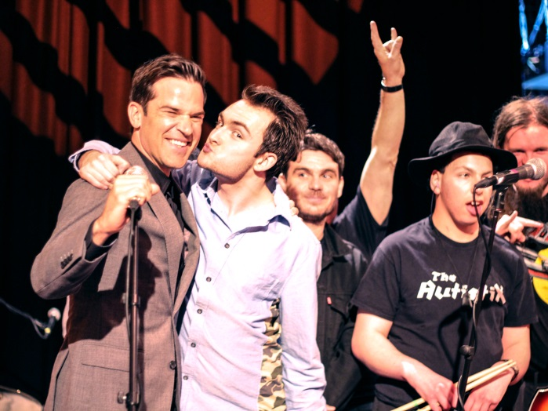
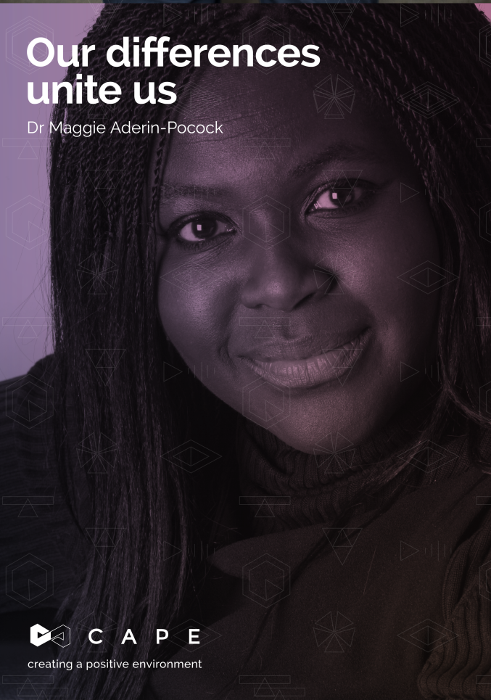
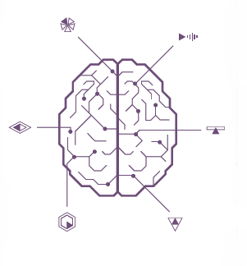
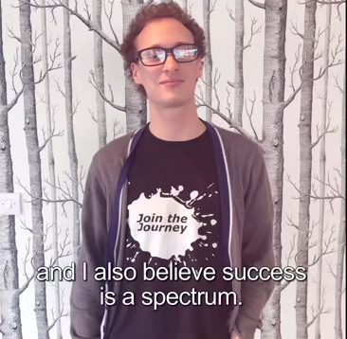
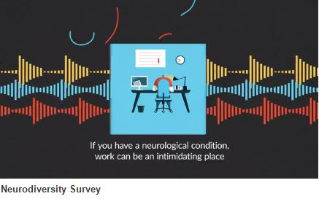
Recognising Talent & Ability
Notes:
Examples of Best Practice:
We wanted to promote the skills and abilities of people with Neurodivergent conditions, highlighting the strengths of differently wired brains which see and access a neurodiverse reality through a different lens.
Too often, only the challenges or negative perceptions of Neurodivergent conditions are discussed or presented, usually given from a Neurotypical perspective.
We identify the opportunities and help to focus in on the positives that Neurodiversity can offer.
It is important to share our work in order to help promote the positive aspects of Neurodiversity and to collaborate with like-minded organisations in order to innovate and identify best practice solutions.
Promote Talent and Skills through industry based events which focus on the positive abilities of new and emerging talent, while also highlighting existing, established talent.

Slide 5
Accessibility
Accessibility was another area noted to present challenges. This applies to areas such as Environment (ie Office spaces, Public spaces & transport, HR processes etc).

Slide 6
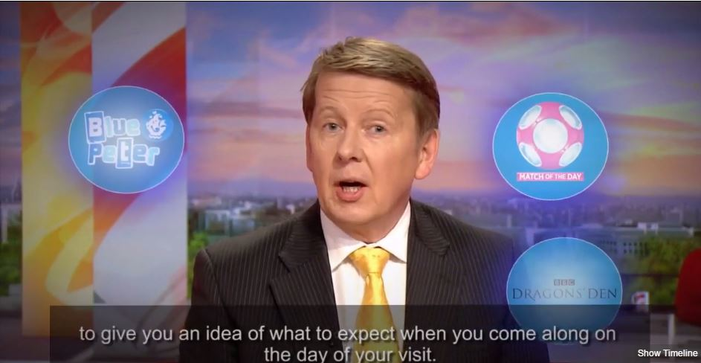
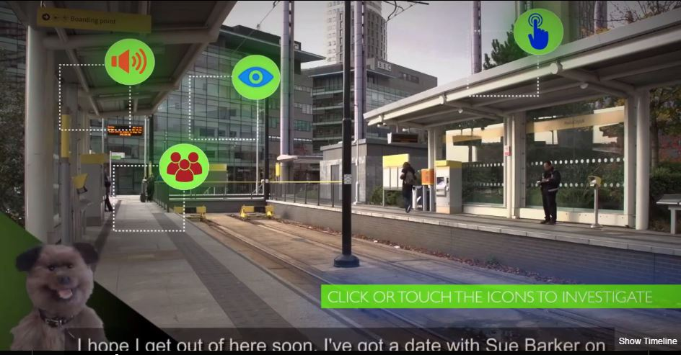
Accessibility
Notes:
Examples of Best Practice: Interactive Access Films
We have also extended the requirement of accessibility to account for people who might want support when visiting our buildings.
We have produced interactive film guides which take the viewer on a journey through the environment they will be visiting and point out some of its features and characteristics.
The film are designed to help someone manage their anxieties and to allow them time to implement or develop any coping strategies and to limit or remove any unnecessary surprises.
We use these films in tandem with narrative & image based accessible information which many organisations currently have.

Slide 7

Accessibility
Notes:
Examples of Best Practice – Building Checklist
We have designed a Neurodiverse buildings checklist to signpost and identify for our workplace teams, areas in the office which might cause issues for people and how areas might be improved.
It can also be used by individual teams, managers or staff, to help in specific cases where someone might require reasonable adjustments applied to their working space or as a prompt for an access interview for a new starter.

Slide 8
Recruitment & Retention
Examples of Best Practice:
Currently reviewing the way we recruit to specify Reasonable Adjustment and offer suggested alternatives to more traditional sit down interviews.
We are considering accessibility of resources , such as internal training, PDR’s, promotional opportunities etc.
Also ran a pilot Work Experience programme to improve opportunities to bridge the gap between Education & Employment

Slide 9
Examples of Best Practice:
Apply User Experience and Design methodology to internal process and practices. Offers a different perspective which builds in Accessibility.
Obtain senior level buy-in for any change programme.
Allow any change process initially to grow organically, rather than apply targets too soon. The change required is Cultural and people need to feel comfortable to disclose. Attempts to measure success too soon will not identify early progress and risk derailing the change programme.
=
+
Different Perspectives
Creativity
Innovation

