Slide 1

Westminster Achieve Ability Commission inquiry into recruitment practice for dyslexic and neurodivergent people.
Opening doors to employment .
Witness
Jo Todd 20th March 2017
All Material ©Jo Todd 2017 www.ndagency.co.uk
Old Village Stores Chedworth Cheltenham Glos. GL54 4AA Tel: 0333 006 2161

Slide 2
Aim:
To highlight the positive contribution of the neurodivergent work force when they have the opportunity to enter the work force in a sustainable environment.
The relevance for 21st Century employers and government to understand the contribution of different thinkers in all areas of the work force .
Best practice and the dignity of difference

Slide 3
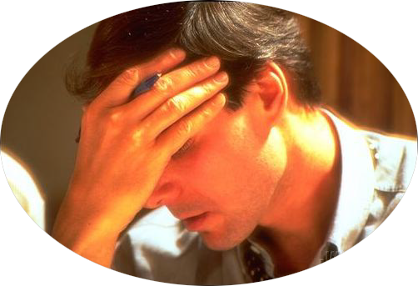
Areas of Concern for Recruitment and Sustainability of Employment
9. ND ‘Sludge’ Employees
10. Sustainability and progression
8. Probationary/ Trial period
1. Job specification
7. Assessment Centres
2. Accessibility of marketing
6 Interview Process
5. Initial Sift
3. Application process
4. Ease of Disclosure

Slide 4
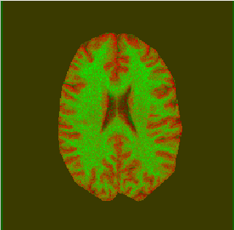
Application, interview , initial training and probationary period
In all stages flexibility of environment ,flexibility of thought, approach and mindset is required.
With too much rigidity the Neurodiverse are unlikely to flourish
⬅➔⬆⬇⬇⬆
 ⬇⬆⬅➔

Slide 5
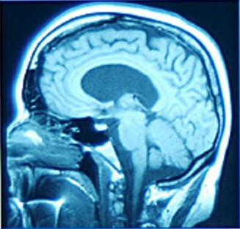
Understanding N/D: The Brain’s Cognitive Functions
Include:
Receiving information
through the senses
Holding information in memory
Recall
Analysing and processing
Delivering information
Neurodiverse thinkers process information differently .

Slide 6
The Triad of responsibility
  Organisation –policy and process
  Individual – self awareness ownership
  Line Manager and Colleagues responsibility
  Government needs to support the alignment
  of the triad if is to flourish

Slide 7
Positive success may mean
Self
Actualisation:
opportunity
and fulfilment
at all levels.
Esteem: reframe job
Descriptions, adapt appraisal and promotion
paths
Belongingness:
Create better understanding across a whole organisation.
Safety: Reframing understanding of what a safe environment means to different individuals
Physiological: Taking account of individual physical needs
My Hierarchy of Neurodiverse Needs

Slide 8
Disability: alienation of the vulnerable N/D community
Outside the community and subsequent alienation and sometimes withdrawal
An individual direction of focus emerges - dependency family/state, legality, self medication
Challenges with all relationships
Divergent skill development occurs
or unfulfilled individuals evolve unemployment , ‘job hoppers’ or undervalued ‘sludge employees’

Slide 9

Dignity of difference
Flexible working hours
Routes for disclosure
Easily accessible assessment
An educated employer
Written materials in dyslexia - friendly style
Informed managers and colleagues
Job carving /job flexibility
Flexible recruitment
Negotiated adjustments during interview and assessment process
Extended probationary periods

Slide 10
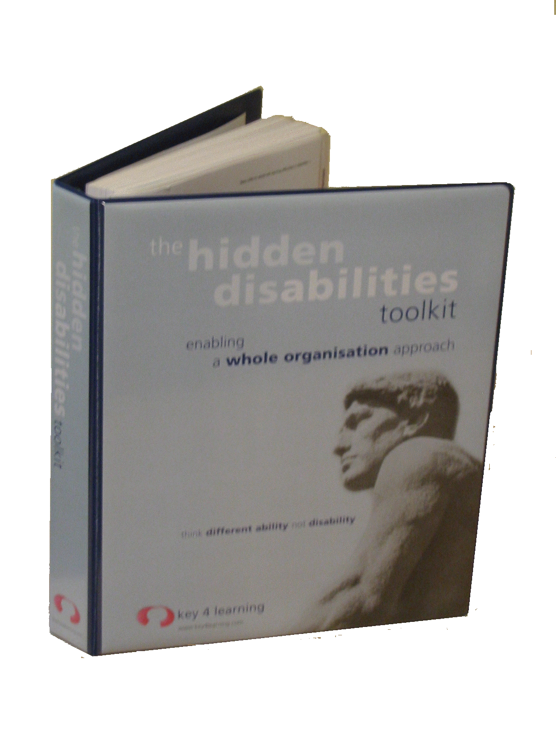
The Whole Organisation Approach
Workmates
Line
Manager
Individual
Staff Training
Reasonable Adjustments
Mentoring
Recruitment and Appraisal
Identification

Slide 11

Deploying Neurodiverse talent is not about
…..husbanding a trickle?

Slide 12
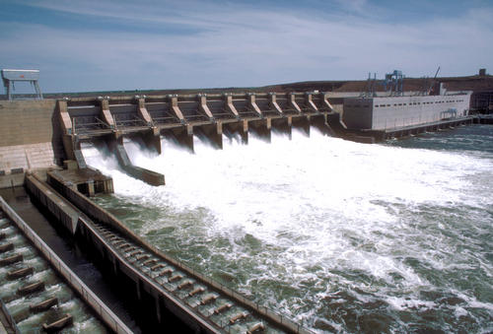
When in a working environment
…with practical skills and appropriate structure, you can fully utilise the resource of the Neurodiverse Community.

Slide 13
Jo Todd jotodd@ndagency.co.uk

